Slide 1
AdoptEase
Making Pet Adoption & Care Easy and Loving
SURAJ PRAJAPATI (2102900100153 / CSE / C)

Slide 2
Objective
Provide Comprehensive Pet Care Resources
Connect Users with Pet Services
Streamline the Pet Adoption Process
Promote Responsible Pet Ownership

Slide 3
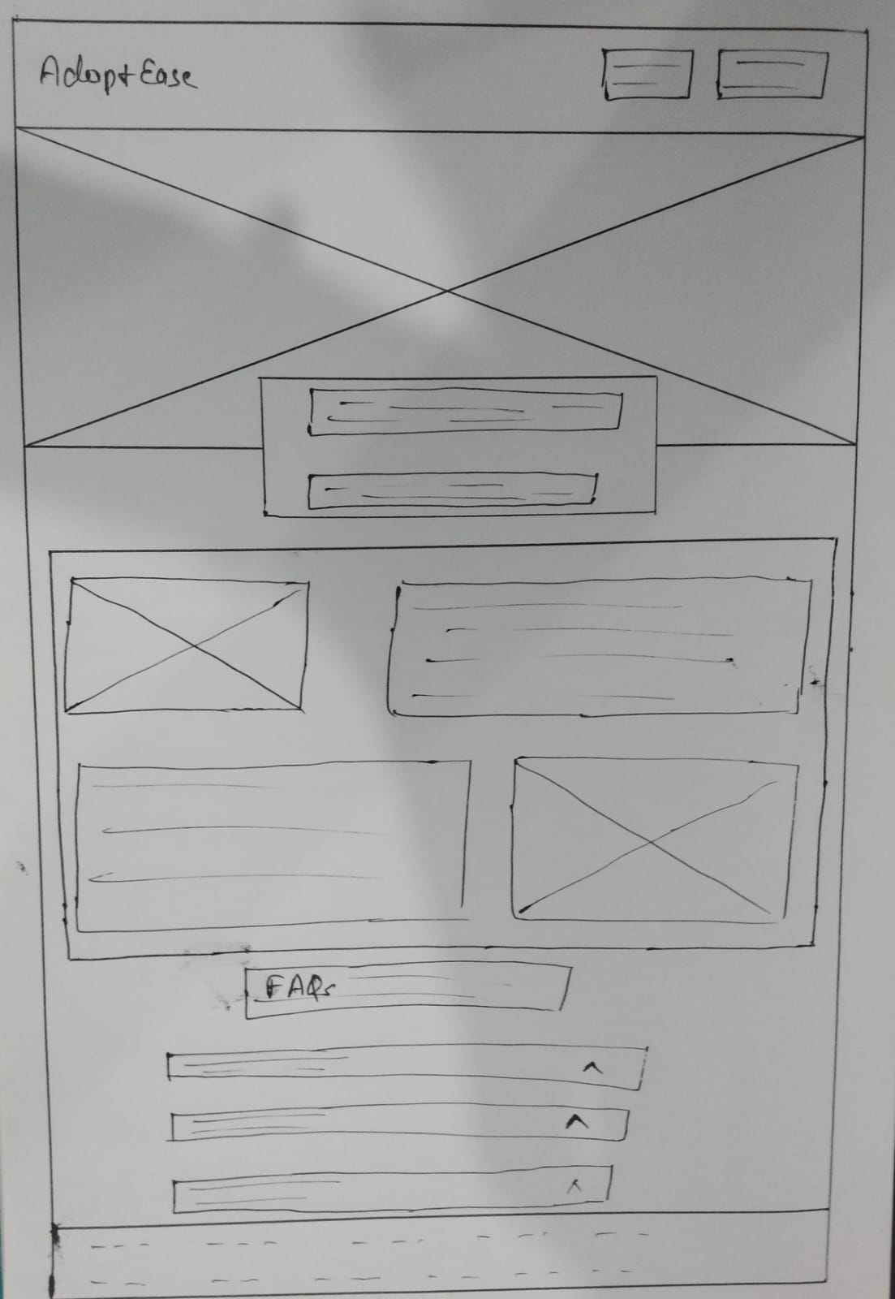
Home Layout

Slide 4
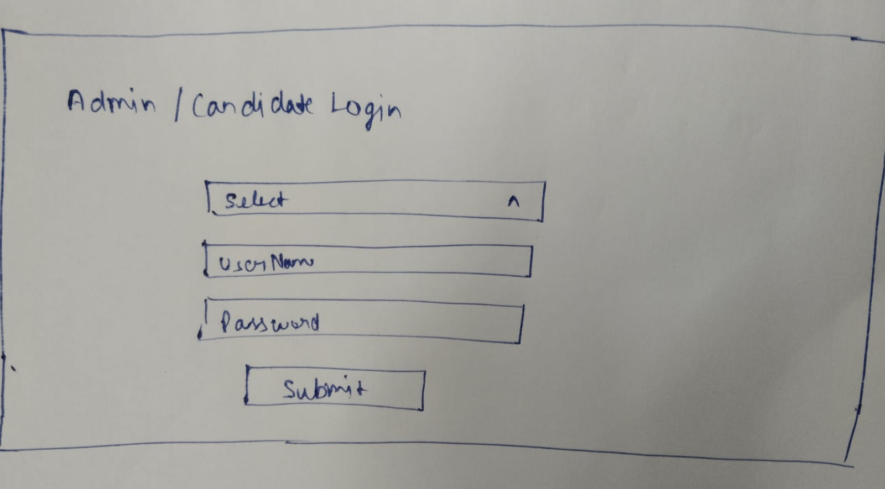
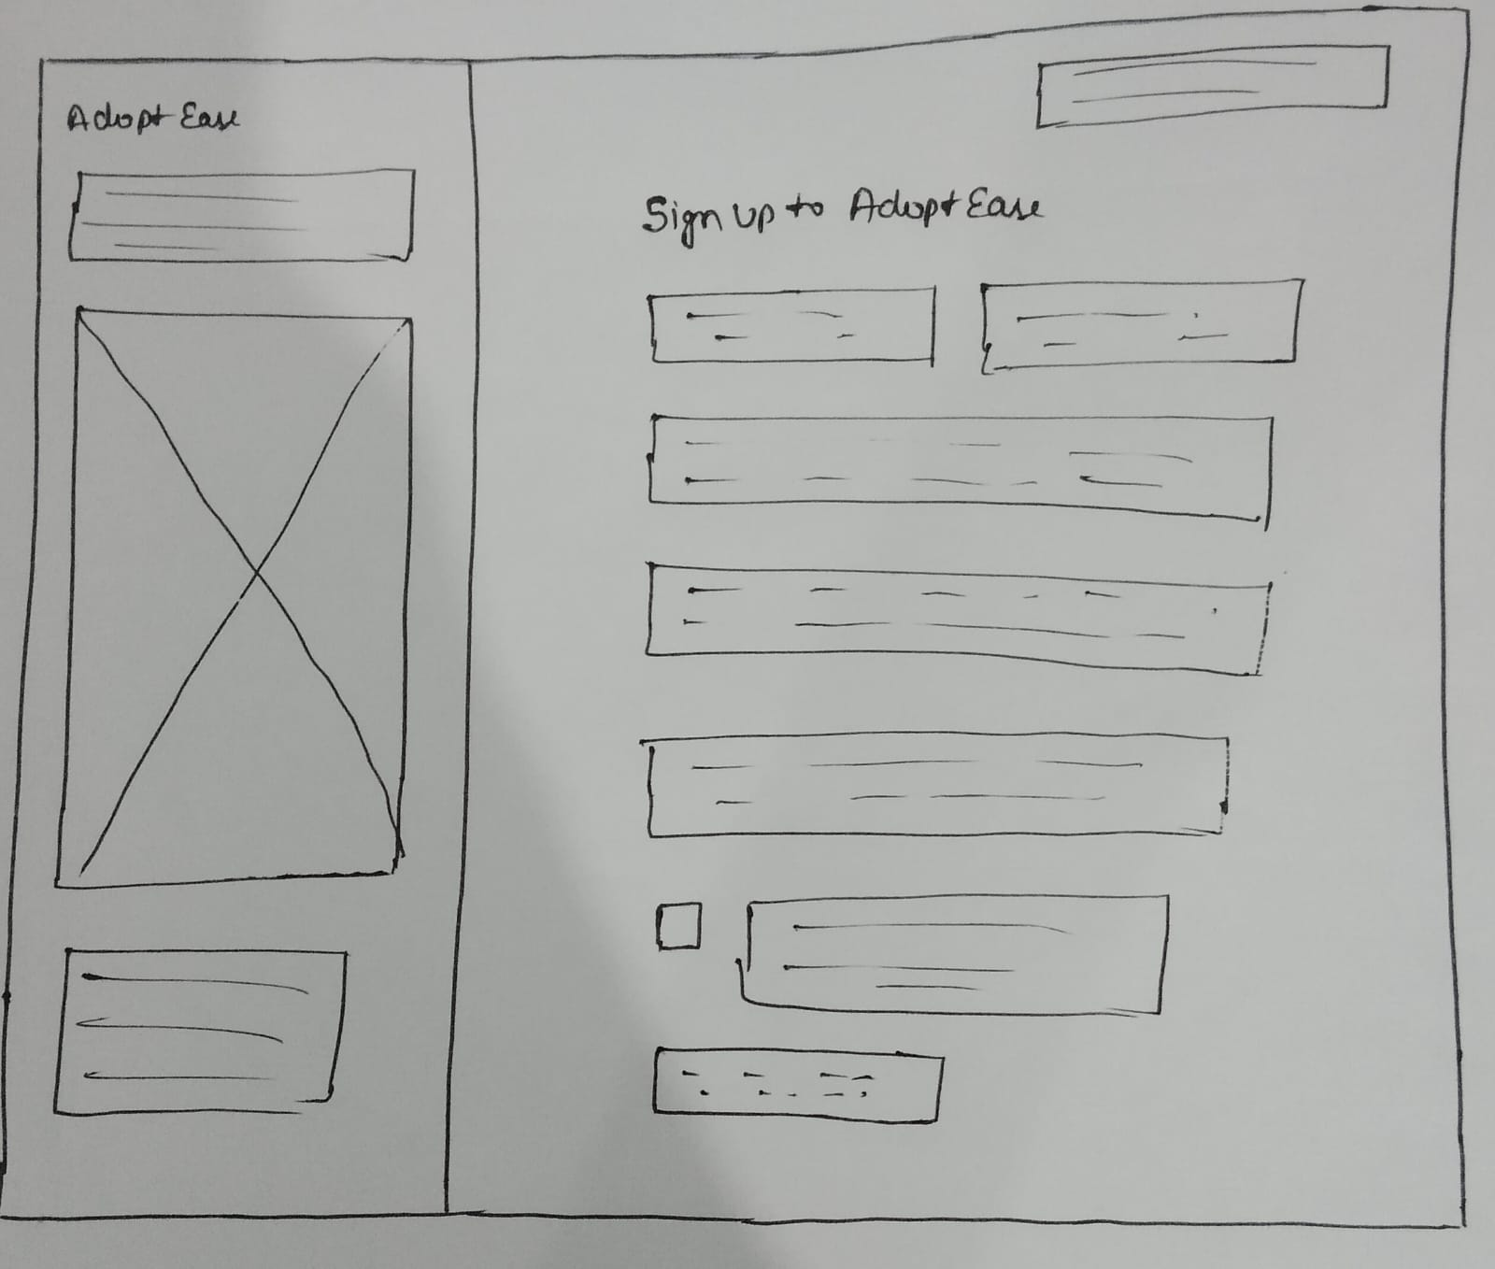
Login Layout
Registration Layout

Slide 5
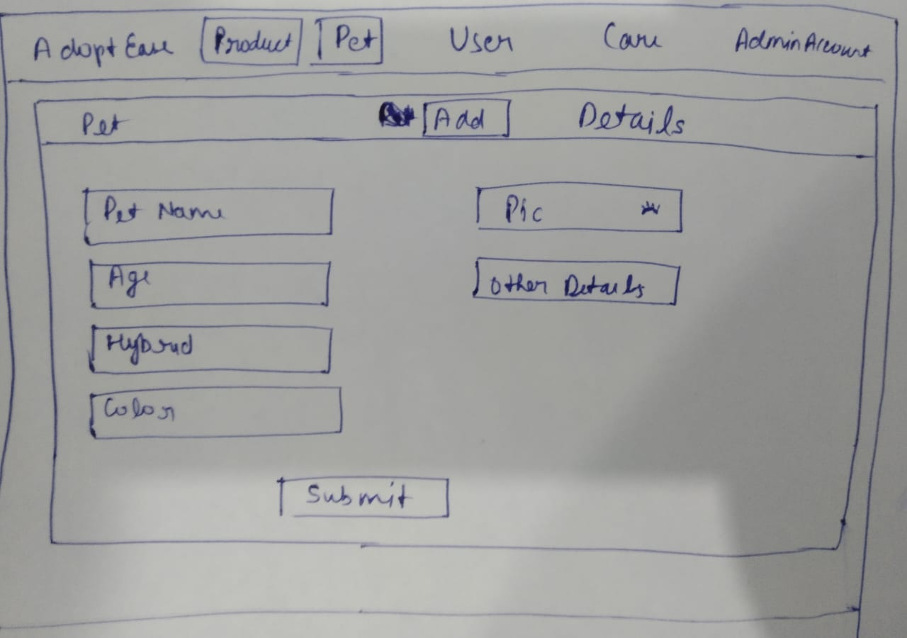
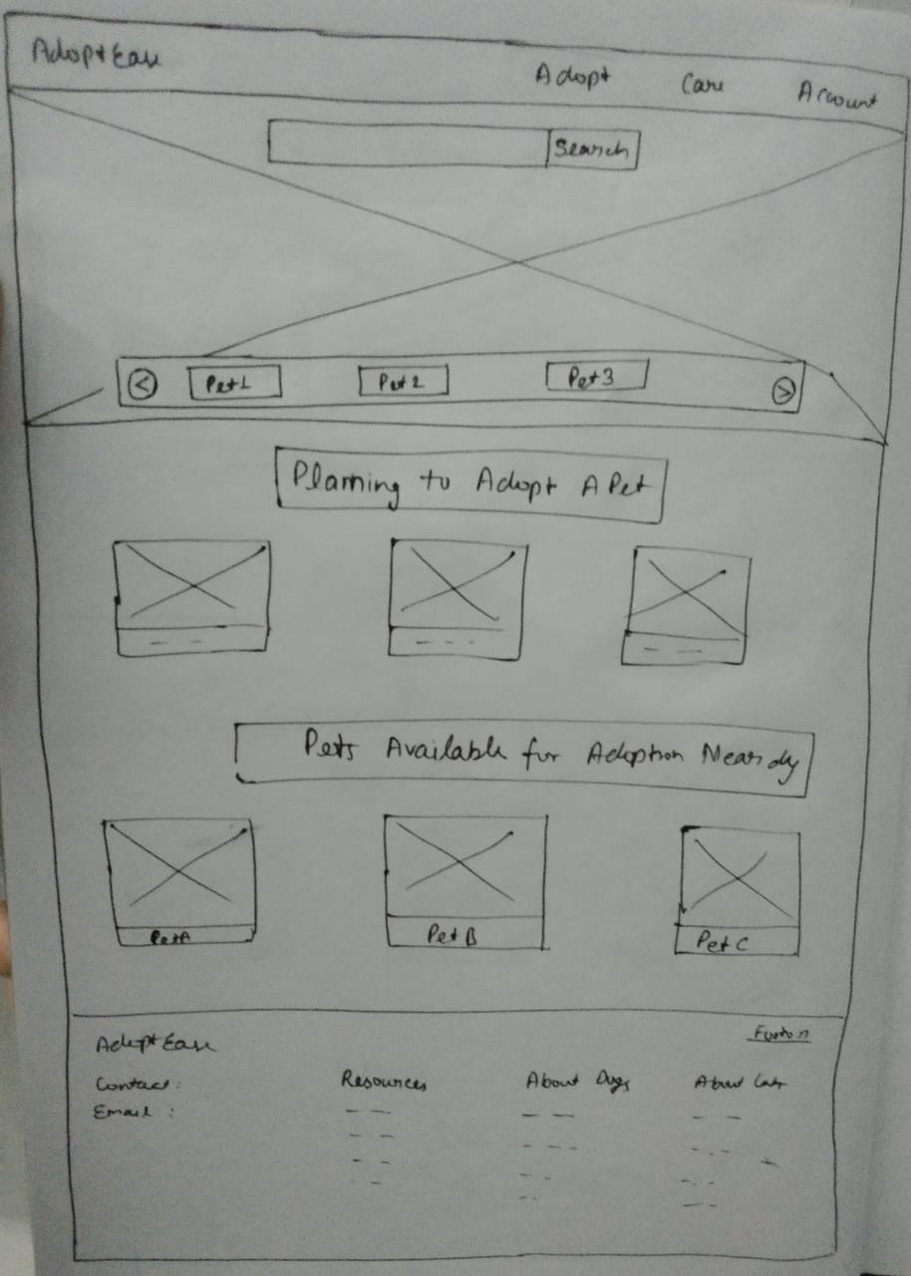
Admin Dashboard Layout
User Dashboard Layout

Slide 6
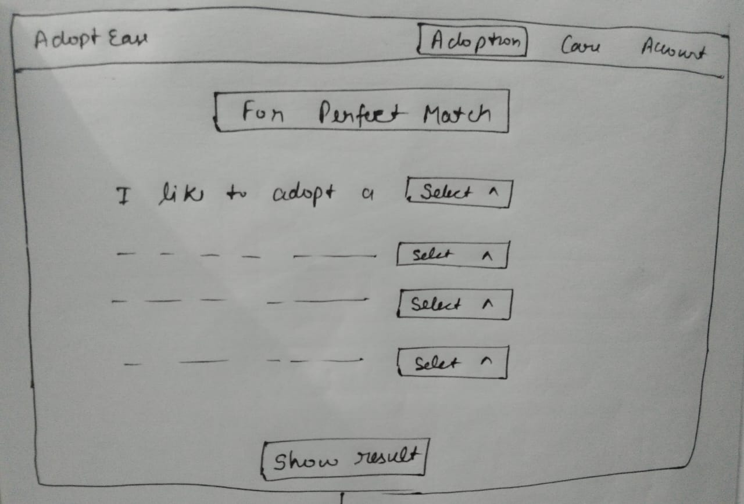
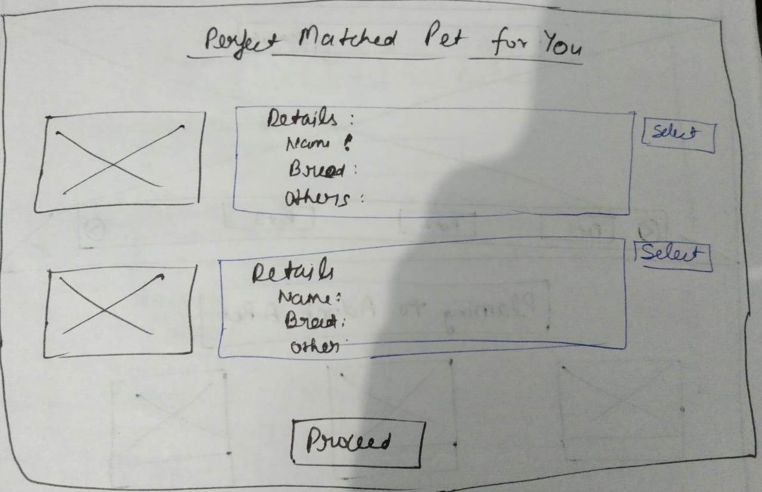
User Pet Adoption Layout

Slide 7
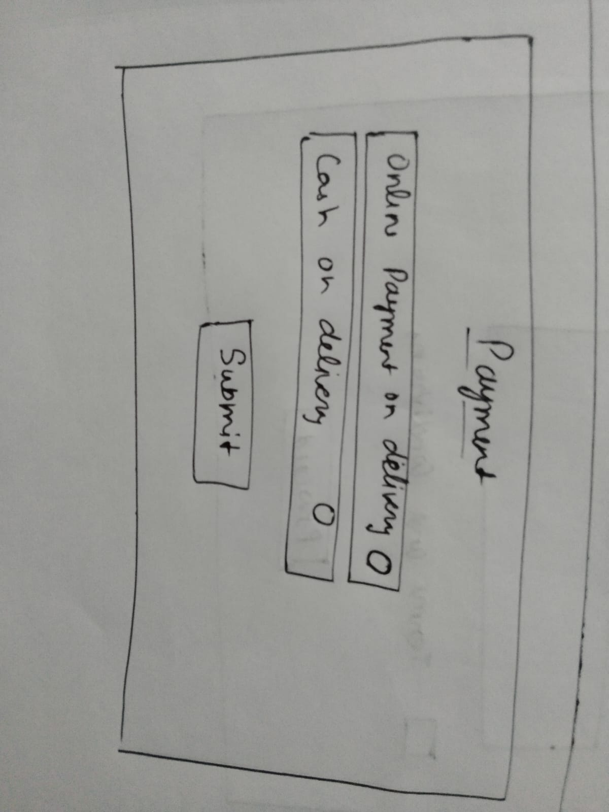
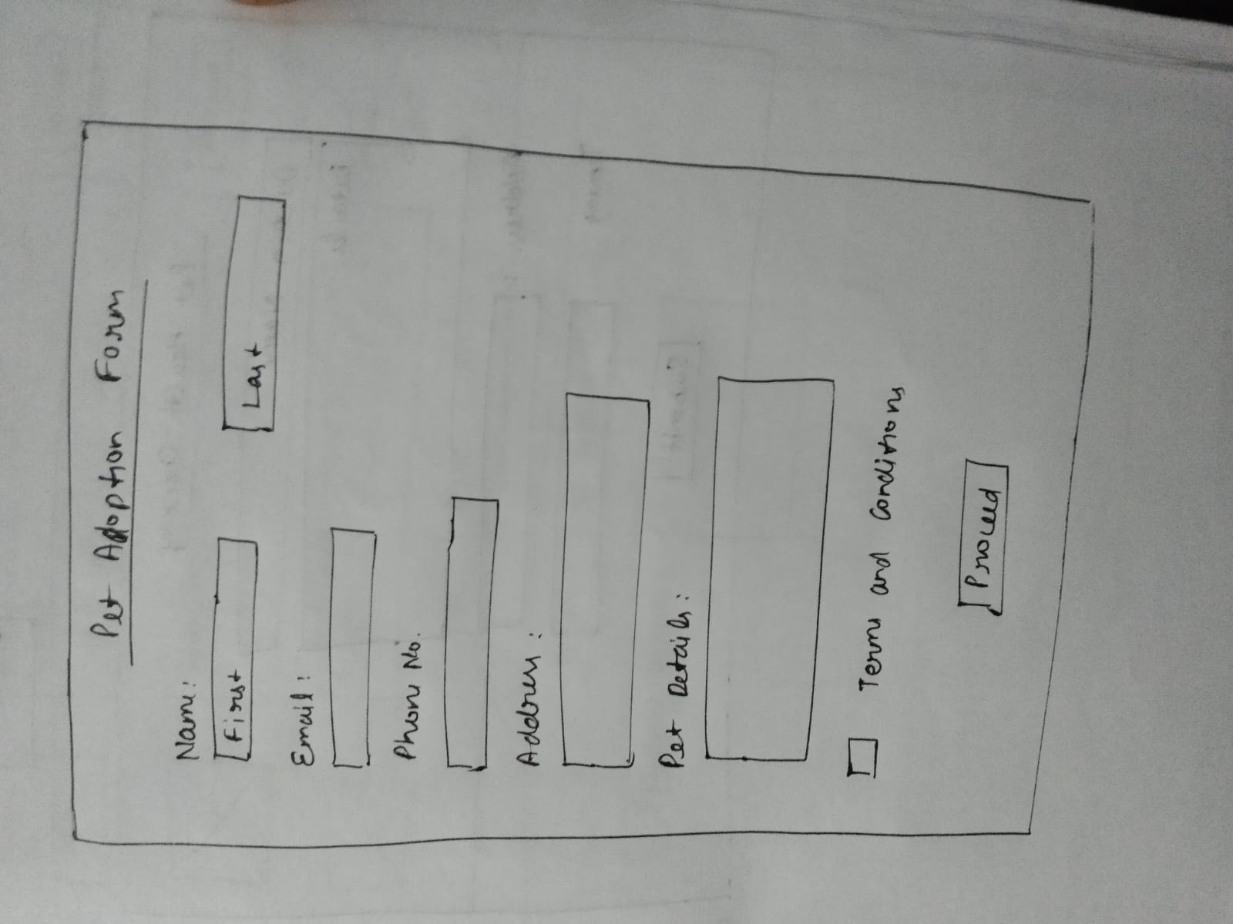
User Pet Adoption Form and Payment Layout

Slide 8
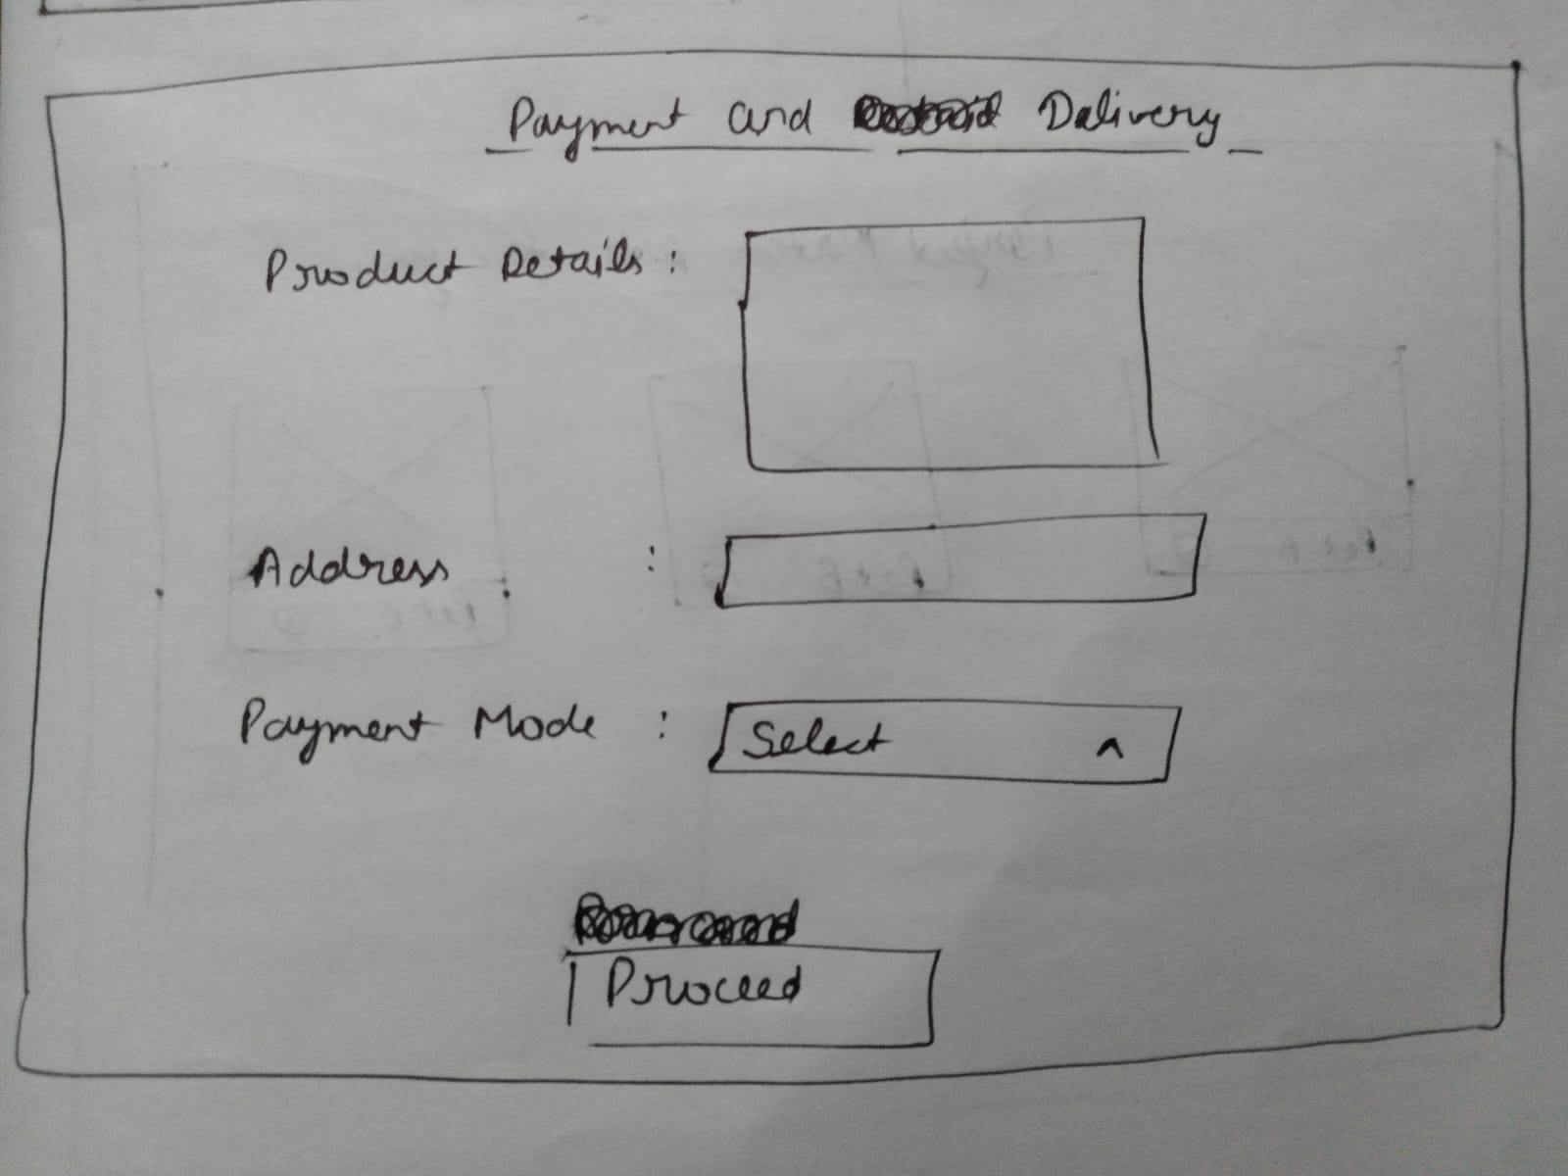
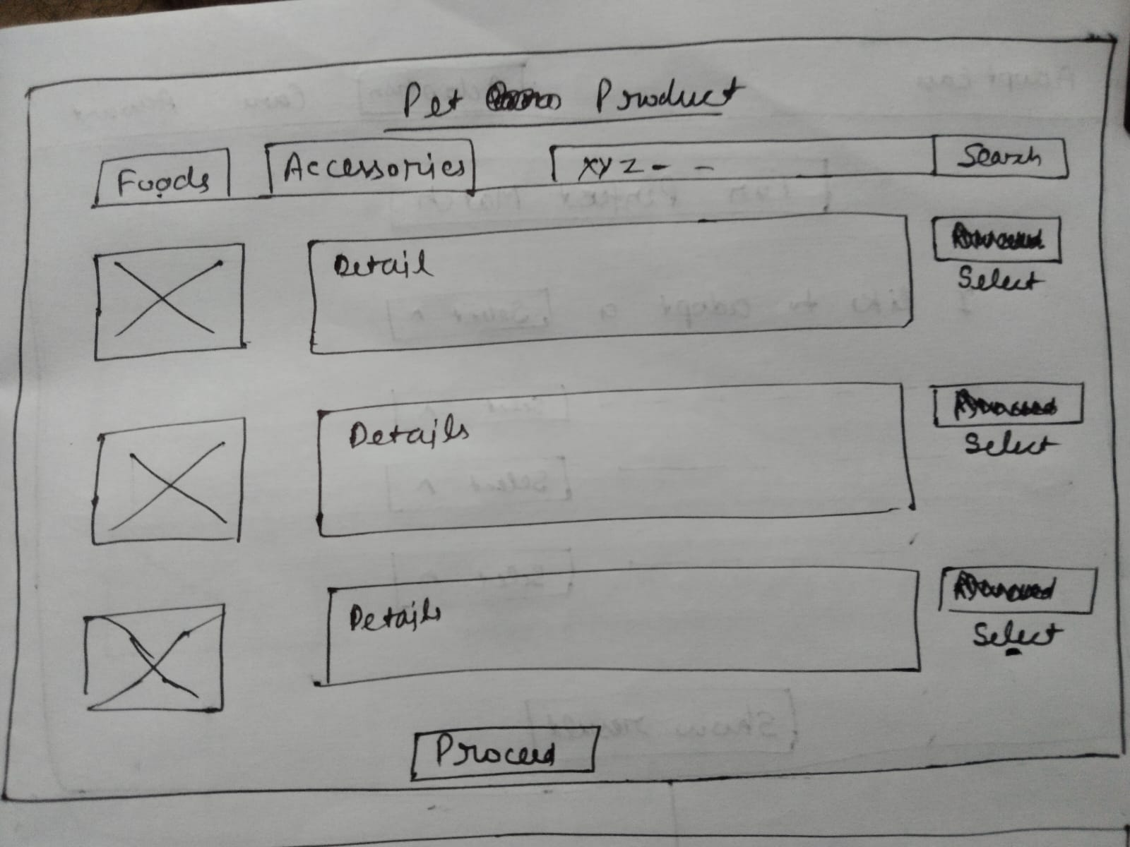
Pets Product Layout

Slide 9
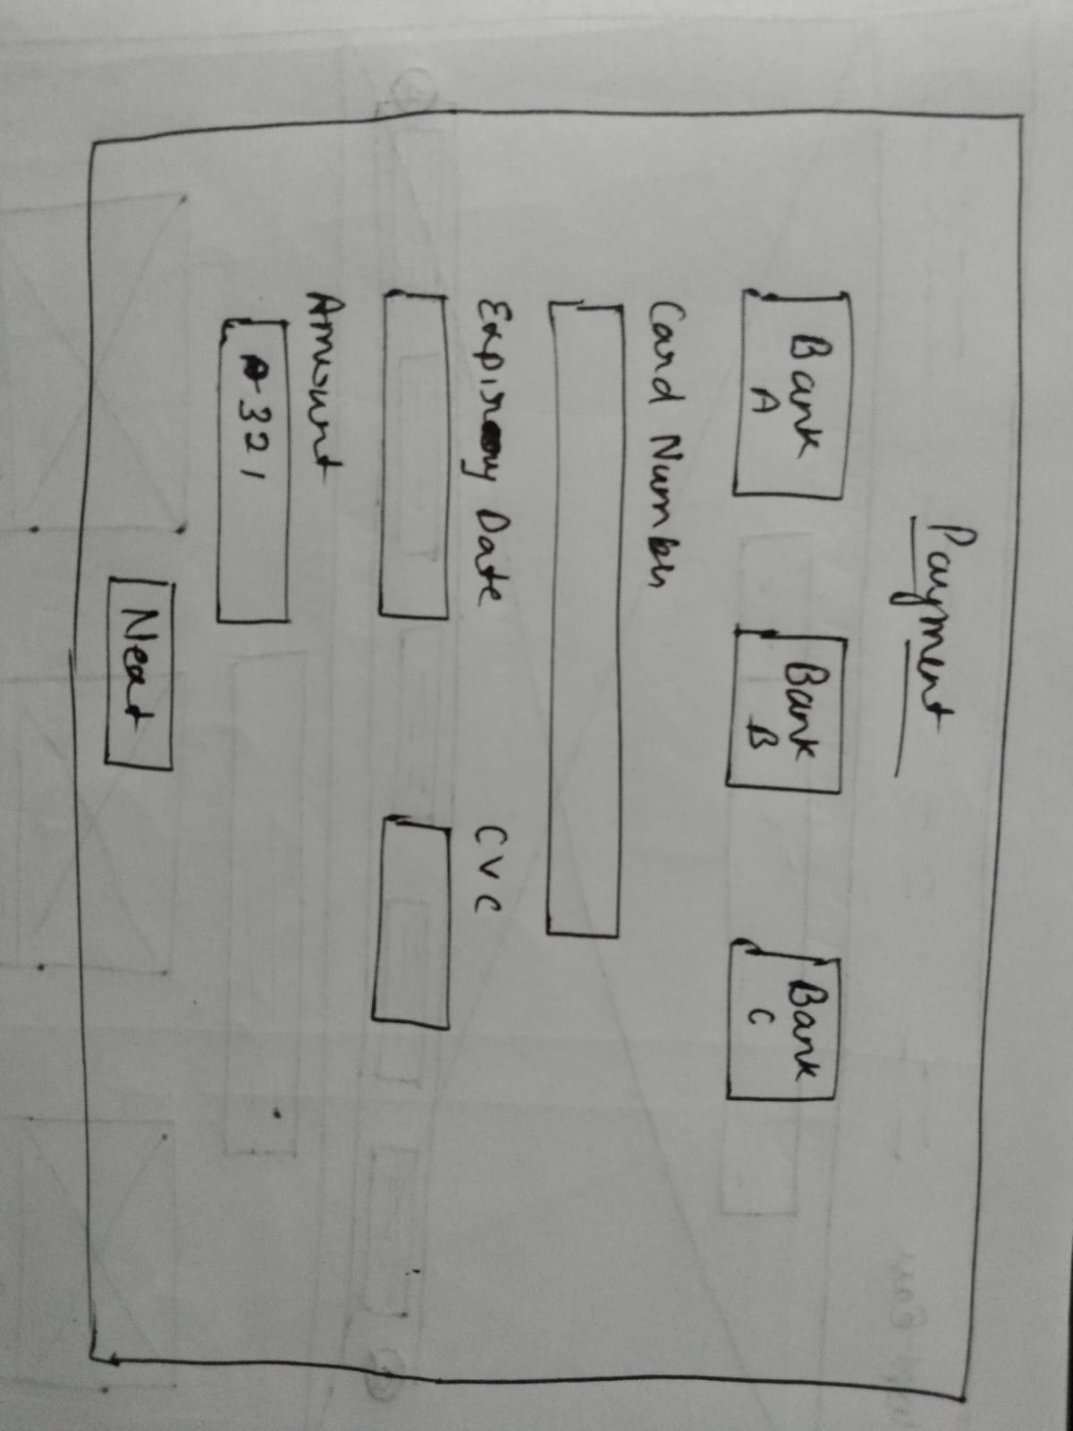
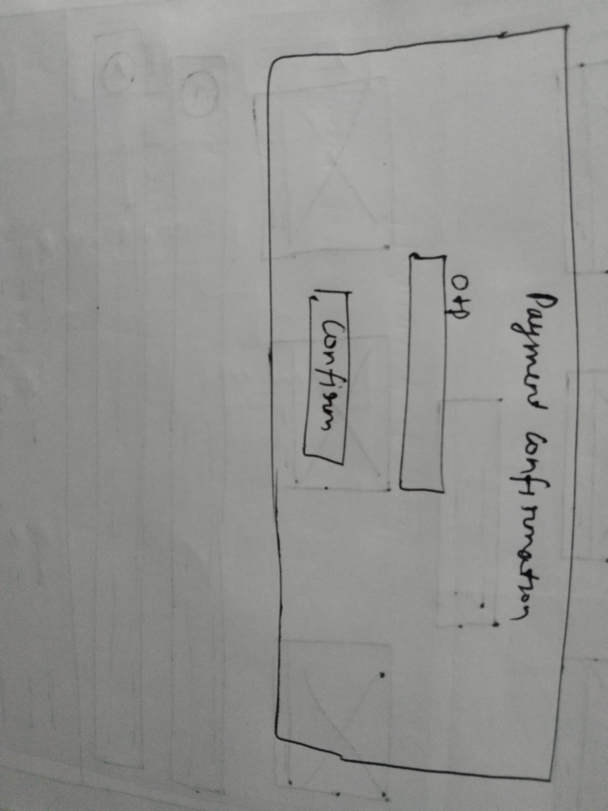
Pets Product Layout

Slide 10
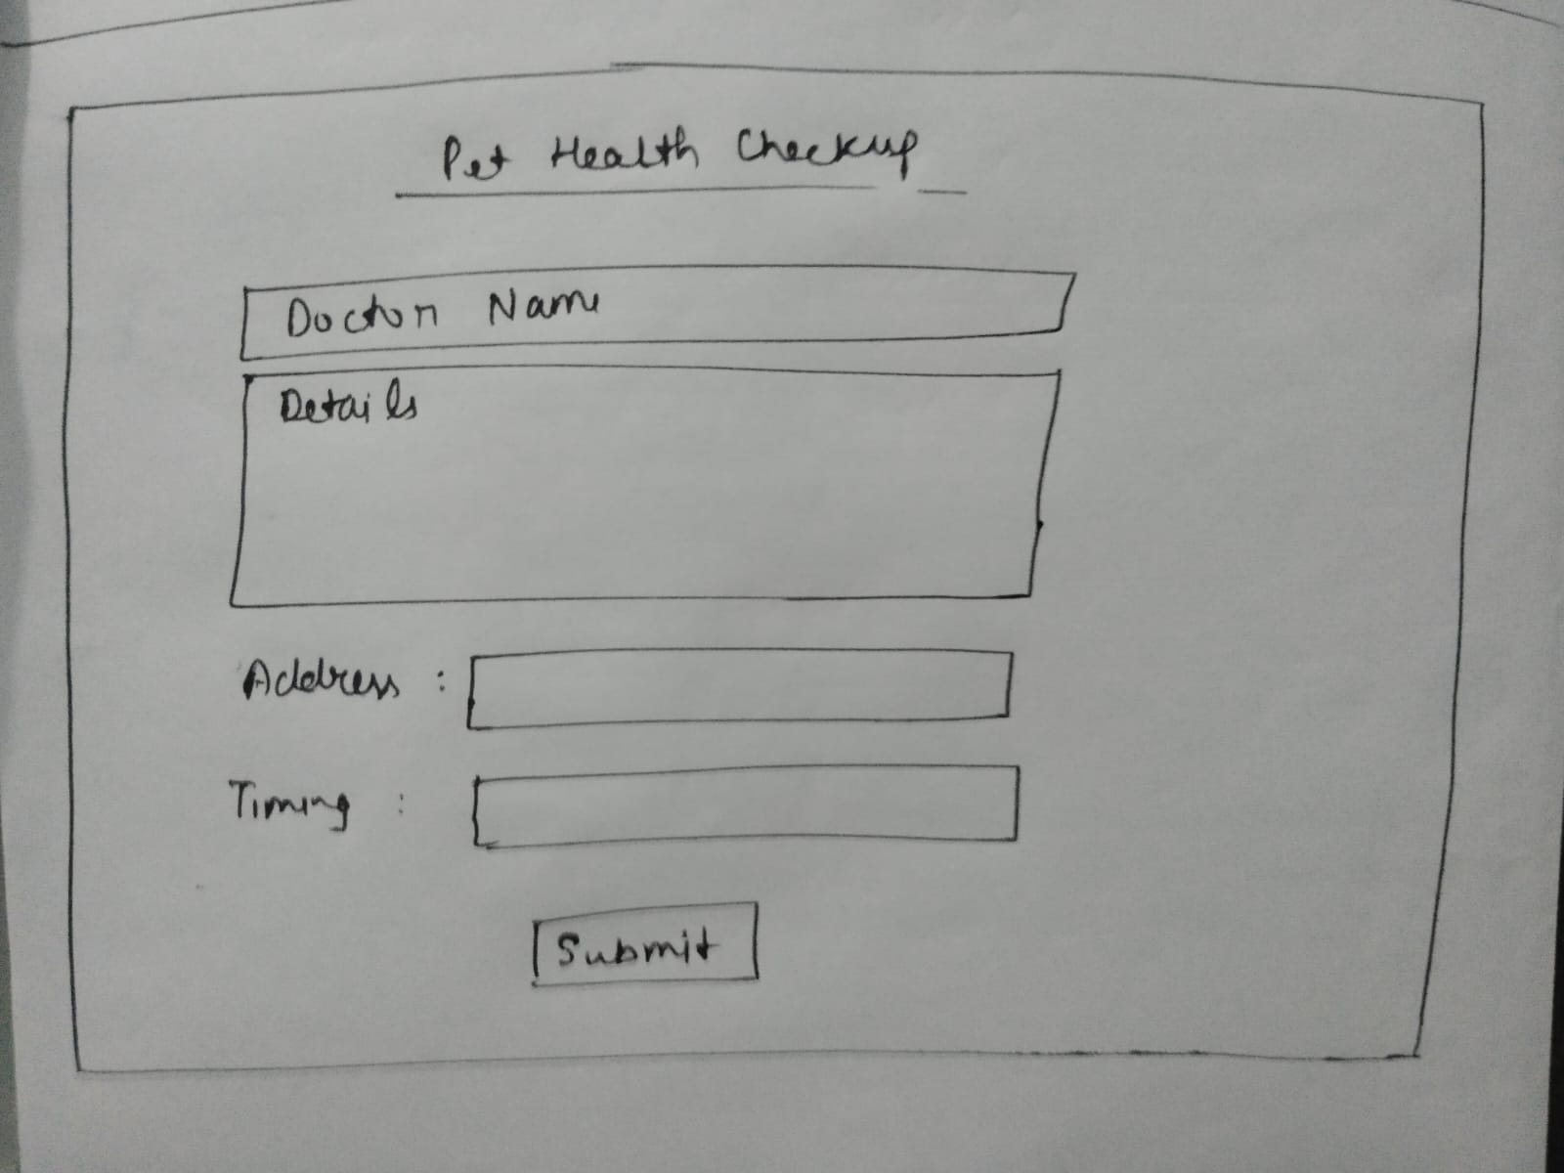
Pets Care Layout

Slide 11
Details About Component
App Component
Header Component
Pet List Component
Pet Details Component
Adoption Form
User Profile Component
Care Resource Component

Slide 12
Thank You👍

